Slide 1


Building Skynet Artificial Intelligence for Malware Development
Steve Salinas
@0xtriboulet

Slide 2



WHOAMI
Steve Salinas
Senior Cybersecurity Researcher, Fortra (Present)
C2 Development
Lead Developer, Datalytica (July)
Adversarial AI/ML Development
United States Marine
Kinetic breaching ☺

Slide 3
WHOAMI
Steve Salinas
Senior Cybersecurity Researcher, Fortra (Present)
C2 Development
Lead Developer, Datalytica (July)
Adversarial AI/ML Development
United States Marine
Kinetic breaching ☺
average “malware developer”

Slide 4


The Problem
Advanced in AI/ML have benefited defensive operators by providing generalized detection engines trained on public and proprietary datasets
Offensive operators have largely not meaningfully capitalized on AI/ML technology
Notes:
For the past several years, we in the security community have witnessed an explosion in the capabilities of defensive teams. One of the ways that blue has been able to outpace red, is through the systematic integration of AI/ML technologies to detections stacks both on end-user devices and in aggregate intelligence resources. Offensive operators, despite evolving in low-level interactions and increasingly refining operational security (opsec) have not experienced the same evolution in capabilities.

Slide 5

Background Information
Skynet when? (What capabilities can AI/ML bring to offensive operations?)
Notes:
The question then becomes, what can AI/ML bring to offensive operations?

Slide 6
Background Information
What capabilities can AI/ML bring to offensive operations?
Some challenges in answering this question...

Slide 7
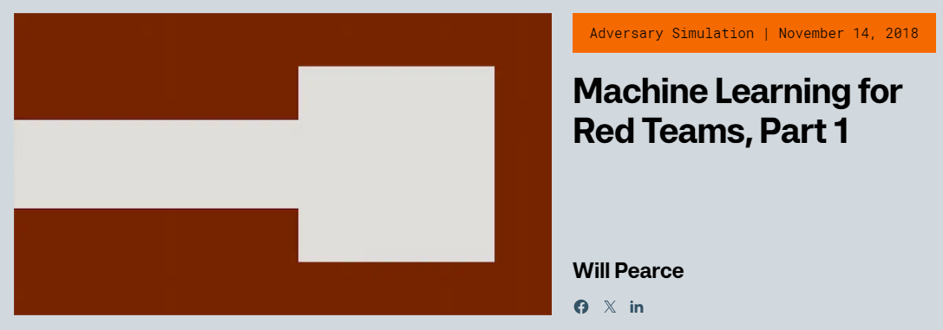
Background Information
What capabilities can AI/ML bring to offensive operations?
Some challenges in answering this question...
Limited existing resources
https://www.netspi.com/blog/technical-blog/adversary-simulation/machine-learning-for-red-teams-part-1/

Slide 8

Background Information
What capabilities can AI/ML bring to offensive operations?
Some challenges in answering this question...
Limited existing resources
https://www.netspi.com/blog/technical-blog/adversary-simulation/machine-learning-for-red-teams-part-1/
https://www.atlan.digital/insights/

Slide 9
Background Information
What capabilities can AI/ML bring to offensive operations?
Some challenges in answering this question...
Limited existing resources
Overemphasis on LLMs/Generative AI

Slide 10

Background Information
What capabilities can AI/ML bring to offensive operations?
Some challenges in answering this question...
Limited existing resources
Overemphasis on LLMs/Generative AI
DuckDuckGo Search August 3rd, 2024

Slide 11
Background Information
What capabilities can AI/ML bring to offensive operations?
Some challenges in answering this question...
Limited existing resources
Overemphasis on LLMs/Generative AI
DuckDuckGo Search August 3rd, 2024

Slide 12
Background Information
What capabilities can AI/ML bring to offensive operations?
Some challenges in answering this question...
Limited existing resources
Overemphasis on LLMs/Generative AI
Attack model limitations

Slide 13
Background Information
What capabilities can AI/ML bring to offensive operations?
Some challenges in answering this question...
Limited existing resources
Overemphasis on LLMs/Generative AI
Attack model limitations
Red Team operations are highly complex. Lessons learned from one environment may not translate across tech stacks, security products, etc...

Slide 14

Background Information
What capabilities can AI/ML bring to offensive operations?
Some challenges in answering this question...
Limited existing resources
Overemphasis on LLMs/Generative AI
Attack model limitations
Red Team operations are highly complex. Lessons learned from one environment may not translate across tech stacks, security products, etc...
The initial question is too generic and abstract

Slide 15
Background Information
What capabilities can AI/ML bring to offensive operations?
Can we use AI/ML to refine existing attack methods?

Slide 16
Background Information
What capabilities can AI/ML bring to offensive operations?
Can we use AI/ML to refine existing attack methods?
Shellcode Loader Design

Slide 17
Background Information
What are “shellcode loaders”?

Slide 18




Background Information
What are “shellcode loaders”?
Attacker Server
Malicious software (.exe, dll, etc...)
Attacker Machine
Target System

Slide 19
Background Information
What are “shellcode loaders”?
Malicious software loads C2 Shellcode based on programmatic logic
Attacker Server
Attacker Machine
Target System

Slide 20
Background Information
What are “shellcode loaders”?
Malicious software loads C2 Shellcode based on programmatic logic
Attacker Server
Anti-VM/Emulation to prevent analysis of shellcode
Guardrails (target verification)
Attacker Machine
Target System

Slide 21
Background Information
What are “shellcode loaders”?
Initiate C2 sessions

Slide 22
Background Information
What are “shellcode loaders”?
Initiate C2 sessions
Can be designed to preemptively detect VM/emulation

Slide 23
Background Information
What are “shellcode loaders”?
Initiate C2 sessions
Can be designed to preemptively detect VM/emulation
Improved OPSEC

Slide 24
Background Information
What are “shellcode loaders”?
Initiate C2 sessions
Can be designed to preemptively detect VM/emulation
Improved OPSEC
Operational considerations
Small size (Mbs?)
Versatile implementation (.exe, .dll, and others)
Few dependencies
No dynamic dependencies to maximize compatibility on target systems

Slide 25
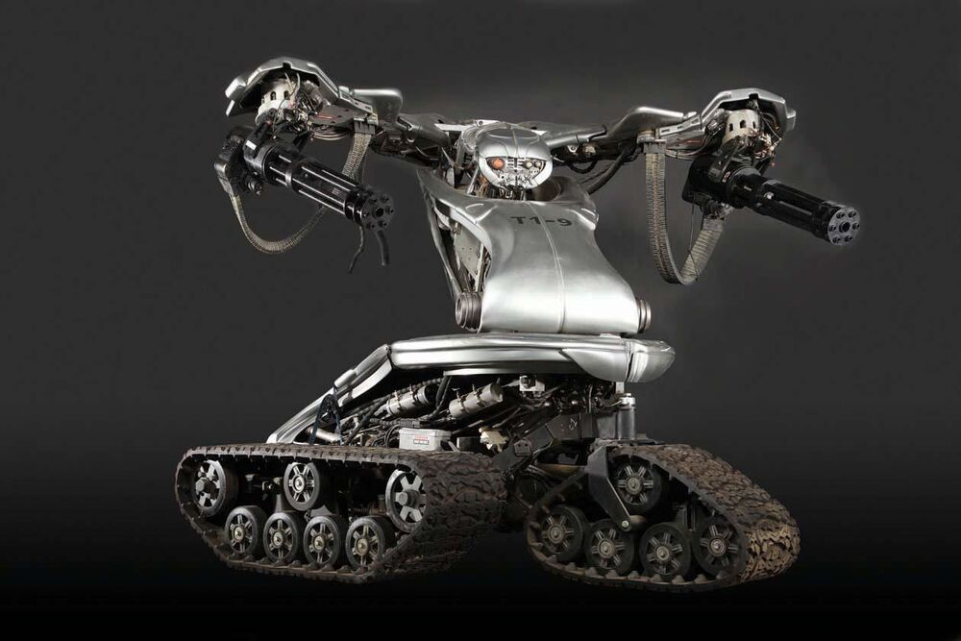
T-1 : Detecting a VM from a loader
https://terminator.fandom.com/wiki/T-1

Slide 26
T-1 : Detecting a VM from a loader
Prior work:
Check Point Research
https://terminator.fandom.com/wiki/T-1

Slide 27
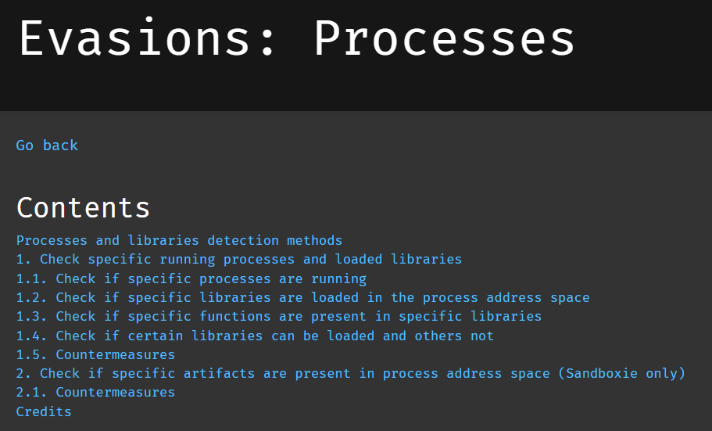
T-1 : Detecting a VM from a loader
Prior work:
Check Point Research
https://evasions.checkpoint.com/src/Evasions/techniques/processes.html
https://terminator.fandom.com/wiki/T-1

Slide 28
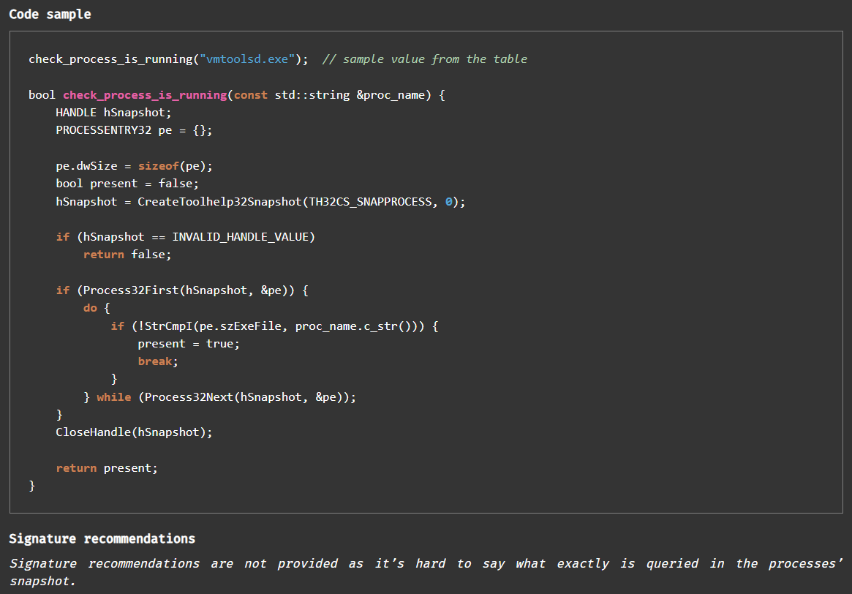
T-1 : Detecting a VM from a loader
Prior work:
Check Point Research
https://evasions.checkpoint.com/src/Evasions/techniques/processes.html
https://terminator.fandom.com/wiki/T-1

Slide 29
T-1 : Detecting a VM from a loader
Prior work:
Check Point Research
https://evasions.checkpoint.com/src/Evasions/techniques/processes.html
https://terminator.fandom.com/wiki/T-1

Slide 30
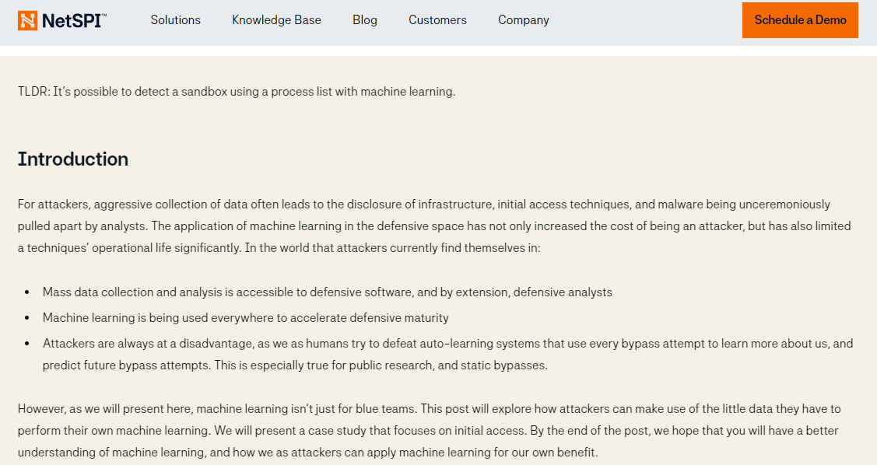
T-1 : Detecting a VM from a loader
Prior work:
NetSPI
https://www.netspi.com/blog/technical-blog/adversary-simulation/machine-learning-for-red-teams-part-1/
https://terminator.fandom.com/wiki/T-1

Slide 31
T-1 : Detecting a VM from a loader
Prior work:
NetSPI
Enumerating unique process counts, number of users, and the unique processes per user creates a discernable pattern between VMs and bare metal machines using neural nets (NN)
https://www.netspi.com/blog/technical-blog/adversary-simulation/machine-learning-for-red-teams-part-1/
https://terminator.fandom.com/wiki/T-1

Slide 32
T-1 : Detecting a VM from a loader
Prior work:
NetSPI
Enumerating unique process counts, number of users, and the unique processes per user creates a discernable pattern between VMs and bare metal machines using neural nets (NN)
Limitations
Python, use of NN, and “extensive” runtime pre-processing due to normalization of data
https://www.netspi.com/blog/technical-blog/adversary-simulation/machine-learning-for-red-teams-part-1/
https://terminator.fandom.com/wiki/T-1

Slide 33
T-1 : Detecting a VM from a loader
Implementing T-1 in C/C++
https://terminator.fandom.com/wiki/T-1
Notes:
https://evasions.checkpoint.com/src/Evasions/techniques/processes.html
https://stackoverflow.com/questions/2686096/c-get-username-from-process

Slide 34
T-1 : Detecting a VM from a loader
Implementing T-1 in C/C++
Constrains viable data analysis mechanics to those that can be implemented in reasonable time (personal patience tbh)
https://terminator.fandom.com/wiki/T-1
Notes:
https://evasions.checkpoint.com/src/Evasions/techniques/processes.html
https://stackoverflow.com/questions/2686096/c-get-username-from-process

Slide 35
T-1 : Detecting a VM from a loader
Implementing T-1 in C/C++
Constrains viable data analysis mechanics to those that can be implemented in reasonable time (personal patience tbh)
Dataset from existing reference material
For simplicity and validation of results
https://terminator.fandom.com/wiki/T-1
Notes:
https://evasions.checkpoint.com/src/Evasions/techniques/processes.html
https://stackoverflow.com/questions/2686096/c-get-username-from-process

Slide 36
T-1 : Detecting a VM from a loader
Implementing T-1 in C/C++
Constrains viable data analysis mechanics to those that can be implemented in reasonable time (personal patience tbh)
Dataset from existing reference material
For simplicity and validation of results
Goal 1: Build model in Python but implement “learnings” in C/C++
https://terminator.fandom.com/wiki/T-1
Notes:
https://evasions.checkpoint.com/src/Evasions/techniques/processes.html
https://stackoverflow.com/questions/2686096/c-get-username-from-process

Slide 37
T-1 : Detecting a VM from a loader
Implementing T-1 in C/C++
Constrains viable data analysis mechanics to those that can be implemented in reasonable time (personal patience tbh)
Dataset from existing reference material
For simplicity and validation of results
Goal 1: Build model in Python but implement “learnings” in C/C++
Goal 2: Distinguish between VM and bare metal machines
with a high degree of confidence
https://terminator.fandom.com/wiki/T-1
Notes:
https://evasions.checkpoint.com/src/Evasions/techniques/processes.html
https://stackoverflow.com/questions/2686096/c-get-username-from-process

Slide 38
T-1 : Detecting a VM from a loader
Python
https://terminator.fandom.com/wiki/T-1
Notes:
https://evasions.checkpoint.com/src/Evasions/techniques/processes.html
https://stackoverflow.com/questions/2686096/c-get-username-from-process

Slide 39
T-1 : Detecting a VM from a loader
Python
Machine learning basics
https://terminator.fandom.com/wiki/T-1
Notes:
https://evasions.checkpoint.com/src/Evasions/techniques/processes.html
https://stackoverflow.com/questions/2686096/c-get-username-from-process

Slide 40
T-1 : Detecting a VM from a loader
Python
Machine learning basics
Data is stored into “dataframes” where columns are “features” and rows are the entries mapped to those features
https://terminator.fandom.com/wiki/T-1
Notes:
https://evasions.checkpoint.com/src/Evasions/techniques/processes.html
https://stackoverflow.com/questions/2686096/c-get-username-from-process

Slide 41
T-1 : Detecting a VM from a loader
Python
Machine learning basics
Data is stored into “dataframes” where columns are “features” and rows are the entries mapped to those features
Creating a model typically requires three steps:
Training
Validation
Testing
https://terminator.fandom.com/wiki/T-1
Notes:
https://evasions.checkpoint.com/src/Evasions/techniques/processes.html
https://stackoverflow.com/questions/2686096/c-get-username-from-process

Slide 42
T-1 : Detecting a VM from a loader
Python – The de facto standard for AI/ML development
https://terminator.fandom.com/wiki/T-1
Notes:
https://evasions.checkpoint.com/src/Evasions/techniques/processes.html
https://stackoverflow.com/questions/2686096/c-get-username-from-process

Slide 43
T-1 : Detecting a VM from a loader
Python – The de facto standard for AI/ML development
Simplify data aggregation and pre-processing
https://terminator.fandom.com/wiki/T-1
Notes:
https://evasions.checkpoint.com/src/Evasions/techniques/processes.html
https://stackoverflow.com/questions/2686096/c-get-username-from-process

Slide 44
T-1 : Detecting a VM from a loader
Python – The de facto standard for AI/ML development
Simplify data aggregation and pre-processing
Sci-kit Learn enables expedient model training and validation
https://terminator.fandom.com/wiki/T-1
Notes:
https://evasions.checkpoint.com/src/Evasions/techniques/processes.html
https://stackoverflow.com/questions/2686096/c-get-username-from-process

Slide 45
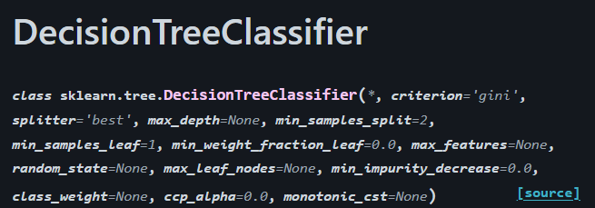
T-1 : Detecting a VM from a loader
Python – The de facto standard for AI/ML development
Simplify data aggregation and pre-processing
Sci-kit Learn enables expedient model training and validation
Decision Tree Classifier
https://scikit-learn.org/stable/modules/generated/sklearn.tree.DecisionTreeClassifier.html
https://terminator.fandom.com/wiki/T-1
Notes:
https://evasions.checkpoint.com/src/Evasions/techniques/processes.html
https://stackoverflow.com/questions/2686096/c-get-username-from-process

Slide 46
T-1 : Detecting a VM from a loader
Python – The de facto standard for AI/ML development
Simplify data aggregation and pre-processing
Sci-kit Learn enables expedient model training and validation
Decision Tree Classifier
Model “learnings” can be expressed as naive conditionals post-training
https://terminator.fandom.com/wiki/T-1
Notes:
https://evasions.checkpoint.com/src/Evasions/techniques/processes.html
https://stackoverflow.com/questions/2686096/c-get-username-from-process

Slide 47
T-1 : Detecting a VM from a loader
Python – The de facto standard for AI/ML development
Simplify data aggregation and pre-processing
Sci-kit Learn enables expedient model training and validation
Decision Tree Classifier
Model “learnings” can be expressed as naive conditionals post-training
We can leverage these learnings in any programming language that supports comparisons (all of them)
https://terminator.fandom.com/wiki/T-1
Notes:
https://evasions.checkpoint.com/src/Evasions/techniques/processes.html
https://stackoverflow.com/questions/2686096/c-get-username-from-process

Slide 48
T-1 : Building the model
Dataset
Three features
number of unique processes, ratio of unique processes / user, number of users
https://terminator.fandom.com/wiki/T-1
Notes:
https://evasions.checkpoint.com/src/Evasions/techniques/processes.html
https://stackoverflow.com/questions/2686096/c-get-username-from-process

Slide 49
T-1 : Building the model
Dataset
Three features
number of unique processes, ratio of unique processes / user, number of users
Initial samples from NetSPI article
https://terminator.fandom.com/wiki/T-1
Notes:
https://evasions.checkpoint.com/src/Evasions/techniques/processes.html
https://stackoverflow.com/questions/2686096/c-get-username-from-process

Slide 50
T-1 : Building the model
Dataset
Three features
number of unique processes, ratio of unique processes / user, number of users
Initial samples from NetSPI article
Collected additional data from security researchers
22 total entries (9 host, 13 VM)
https://terminator.fandom.com/wiki/T-1
Notes:
https://evasions.checkpoint.com/src/Evasions/techniques/processes.html
https://stackoverflow.com/questions/2686096/c-get-username-from-process

Slide 51
T-1 : Building the model
Dataset
Three features
number of unique processes, ratio of unique processes / user, number of users
Initial samples from NetSPI article
Collected additional data from security researchers
22 total entries (9 host, 13 VM)
Biases and outlier analysis on the data are out of scope
https://terminator.fandom.com/wiki/T-1
Notes:
https://evasions.checkpoint.com/src/Evasions/techniques/processes.html
https://stackoverflow.com/questions/2686096/c-get-username-from-process

Slide 52
T-1 : Building the model
Training
https://terminator.fandom.com/wiki/T-1
Notes:
https://evasions.checkpoint.com/src/Evasions/techniques/processes.html
https://stackoverflow.com/questions/2686096/c-get-username-from-process

Slide 53
T-1 : Building the model
Training
75% of the data (16 entries) used for training/validation
https://terminator.fandom.com/wiki/T-1
Notes:
https://evasions.checkpoint.com/src/Evasions/techniques/processes.html
https://stackoverflow.com/questions/2686096/c-get-username-from-process

Slide 54
T-1 : Building the model
Training
75% of the data (16 entries) used for training/validation
Pre-processing data augmentation via stochastic resampling
100 samples used at training time
https://terminator.fandom.com/wiki/T-1
Notes:
https://evasions.checkpoint.com/src/Evasions/techniques/processes.html
https://stackoverflow.com/questions/2686096/c-get-username-from-process

Slide 55
T-1 : Building the model
Training
75% of the data (16 entries) used for training/validation
Pre-processing data augmentation via stochastic resampling
100 samples used at training time
Validation
5000 rounds of automated random search hyperparameter tuning and cross-validation with RandomizedSearchCV
https://terminator.fandom.com/wiki/T-1
Notes:
https://evasions.checkpoint.com/src/Evasions/techniques/processes.html
https://stackoverflow.com/questions/2686096/c-get-username-from-process

Slide 56
T-1 : Building the model
Training
75% of the data (16 entries) used for training/validation
Pre-processing data augmentation via stochastic resampling
100 samples used at training time
Validation
5000 rounds of automated random search hyperparameter tuning and cross-validation with RandomizedSearchCV
Testing
Final round of testing against unseen data (6 entries)
https://terminator.fandom.com/wiki/T-1
Notes:
https://evasions.checkpoint.com/src/Evasions/techniques/processes.html
https://stackoverflow.com/questions/2686096/c-get-username-from-process

Slide 57
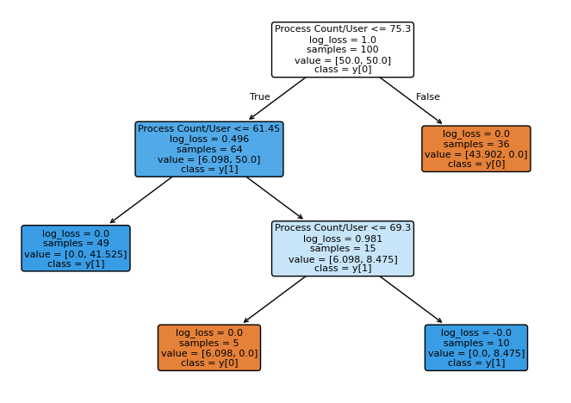
T-1 : Building the model
Bare Metal
Virtual Machine
Bare Metal
Virtual Machine
https://terminator.fandom.com/wiki/T-1
Notes:
https://evasions.checkpoint.com/src/Evasions/techniques/processes.html
https://stackoverflow.com/questions/2686096/c-get-username-from-process

Slide 58
T-1 : Building the model
Bare Metal
Virtual Machine
Bare Metal
Virtual Machine
https://terminator.fandom.com/wiki/T-1
Notes:
https://evasions.checkpoint.com/src/Evasions/techniques/processes.html
https://stackoverflow.com/questions/2686096/c-get-username-from-process

Slide 59
T-1 : Building the model
if ((process_count_per_user > 75.3) || (process_count_per_user > 61.45 && process_count_per_user <= 69.3))
{ // Bare metal machine
}
Bare Metal
Virtual Machine
Bare Metal
Virtual Machine
https://terminator.fandom.com/wiki/T-1
Notes:
https://evasions.checkpoint.com/src/Evasions/techniques/processes.html
https://stackoverflow.com/questions/2686096/c-get-username-from-process

Slide 60
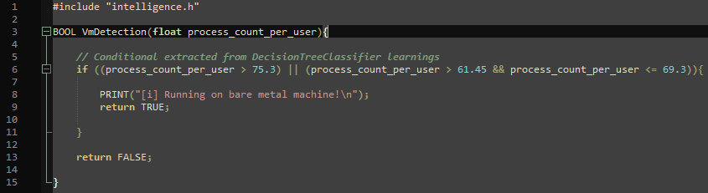
T-1 : Building the model
if ((process_count_per_user > 75.3) || (process_count_per_user > 61.45 && process_count_per_user <= 69.3))
{ // Bare metal machine
}
Bare Metal
Virtual Machine
Bare Metal
Virtual Machine
https://terminator.fandom.com/wiki/T-1
Notes:
https://evasions.checkpoint.com/src/Evasions/techniques/processes.html
https://stackoverflow.com/questions/2686096/c-get-username-from-process

Slide 61
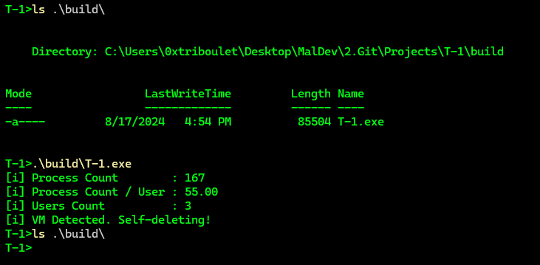
T-1 : Building the model
if ((process_count_per_user > 75.3) || (process_count_per_user > 61.45 && process_count_per_user <= 69.3))
{ // Bare metal machine
}
Bare Metal
Virtual Machine
Bare Metal
Virtual Machine
VirtualBox
https://terminator.fandom.com/wiki/T-1
Notes:
https://evasions.checkpoint.com/src/Evasions/techniques/processes.html
https://stackoverflow.com/questions/2686096/c-get-username-from-process

Slide 62
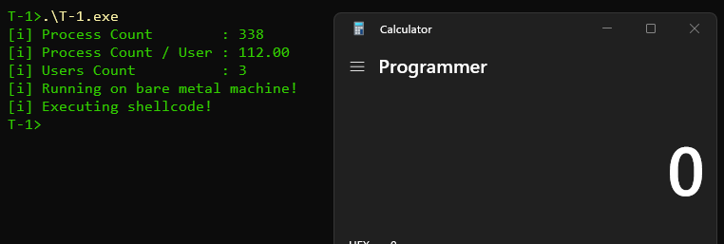
T-1 : Building the model
if ((process_count_per_user > 75.3) || (process_count_per_user > 61.45 && process_count_per_user <= 69.3))
{ // Bare metal machine
}
Bare Metal
Virtual Machine
Bare Metal
Virtual Machine
Host Machine
https://terminator.fandom.com/wiki/T-1
Notes:
https://evasions.checkpoint.com/src/Evasions/techniques/processes.html
https://stackoverflow.com/questions/2686096/c-get-username-from-process

Slide 63
T-1 : Building the model
Advantages of this approach
https://terminator.fandom.com/wiki/T-1
Notes:
https://evasions.checkpoint.com/src/Evasions/techniques/processes.html
https://stackoverflow.com/questions/2686096/c-get-username-from-process

Slide 64
T-1 : Building the model
Advantages of this approach
Extracting the conditional expression of a DTC allows for its use in any programming language
https://terminator.fandom.com/wiki/T-1
Notes:
https://evasions.checkpoint.com/src/Evasions/techniques/processes.html
https://stackoverflow.com/questions/2686096/c-get-username-from-process

Slide 65
T-1 : Building the model
Advantages of this approach
Extracting the conditional expression of a DTC allows for its use in any programming language
Opaque conditional captures functionality that would typically be unmasked by string analysis with string utility or FLOSS
https://terminator.fandom.com/wiki/T-1
Notes:
https://evasions.checkpoint.com/src/Evasions/techniques/processes.html
https://stackoverflow.com/questions/2686096/c-get-username-from-process

Slide 66
T-1 : Building the model
Advantages of this approach
Extracting the conditional expression of a DTC allows for its use in any programming language
Opaque conditional captures functionality that would typically be unmasked by string analysis with string utility or FLOSS
Overcomes some types of VM masking that may defeat conventional VM detection
https://terminator.fandom.com/wiki/T-1
Notes:
https://evasions.checkpoint.com/src/Evasions/techniques/processes.html
https://stackoverflow.com/questions/2686096/c-get-username-from-process

Slide 67
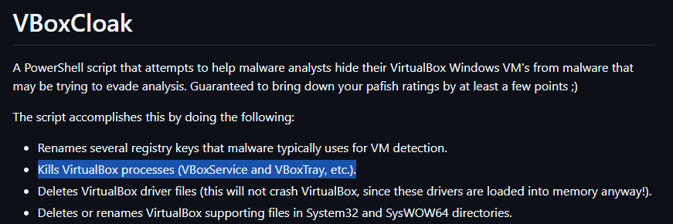
T-1 : Building the model
Advantages of this approach
Extracting the conditional expression of a DTC allows for its use in any programming language
Opaque conditional captures functionality that would typically be unmasked by strings
Overcomes some types of VM masking
https://github.com/d4rksystem/VBoxCloak
https://terminator.fandom.com/wiki/T-1
Notes:
https://evasions.checkpoint.com/src/Evasions/techniques/processes.html
https://stackoverflow.com/questions/2686096/c-get-username-from-process

Slide 68
T-1 : Building the model
Advantages of this approach
Extracting the conditional expression of a DTC allows for its use in any programming language
Opaque conditional captures functionality that would typically be unmasked by string analysis with string utility or FLOSS
Overcomes some types of VM masking
Disadvantages of this approach
More complex than other approaches, requires enumerating processes and users
https://terminator.fandom.com/wiki/T-1
Notes:
https://evasions.checkpoint.com/src/Evasions/techniques/processes.html
https://stackoverflow.com/questions/2686096/c-get-username-from-process

Slide 69
T-1 : Building the model
Advantages of this approach
Extracting the conditional expression of a DTC allows for its use in any programming language
Opaque conditional captures functionality that would typically be unmasked by string analysis with string utility or FLOSS
Overcomes some types of VM masking
Disadvantages of this approach
More complex than other approaches, requires enumerating processes and users
Truly operational implementation would require accounting for biases in data
https://terminator.fandom.com/wiki/T-1

Slide 70
Back to our question
Can we use AI/ML to refine existing attack methods?
Loader Design
https://terminator.fandom.com/wiki/T-1
Notes:
https://evasions.checkpoint.com/src/Evasions/techniques/processes.html
https://stackoverflow.com/questions/2686096/c-get-username-from-process

Slide 71
Back to our question
Can we use AI/ML to refine existing attack methods?
Loader Design
VM Detection
https://terminator.fandom.com/wiki/T-1
Notes:
https://evasions.checkpoint.com/src/Evasions/techniques/processes.html
https://stackoverflow.com/questions/2686096/c-get-username-from-process

Slide 72

Back to our question
Can we use AI/ML to refine existing attack methods?
Loader Design
VM Detection
https://terminator.fandom.com/wiki/T-1
Notes:
https://evasions.checkpoint.com/src/Evasions/techniques/processes.html
https://stackoverflow.com/questions/2686096/c-get-username-from-process

Slide 73

Back to our question
Can we use AI/ML to refine existing attack methods?
Loader Design
VM Detection
Target User Verification
https://terminator.fandom.com/wiki/T-1
Notes:
https://evasions.checkpoint.com/src/Evasions/techniques/processes.html
https://stackoverflow.com/questions/2686096/c-get-username-from-process

Slide 74
Using AI to Find John Connor
Design considerations
Notes:
https://evasions.checkpoint.com/src/Evasions/techniques/processes.html
https://stackoverflow.com/questions/2686096/c-get-username-from-process

Slide 75
Using AI to Find John Connor
Design considerations
Compiled language for maximum low-level control
Notes:
https://evasions.checkpoint.com/src/Evasions/techniques/processes.html
https://stackoverflow.com/questions/2686096/c-get-username-from-process

Slide 76
Using AI to Find John Connor
Design considerations
Compiled language for maximum low-level control
Minimal runtime dependencies (PyTorch, Tensorflow, OpenCV)
Notes:
https://evasions.checkpoint.com/src/Evasions/techniques/processes.html
https://stackoverflow.com/questions/2686096/c-get-username-from-process

Slide 77
Using AI to Find John Connor
Design considerations
Compiled language for maximum low-level control
Minimal runtime dependencies (PyTorch, Tensorflow, OpenCV)
Leverage existing AI ecosystem to overcome AI development overhead
Notes:
https://evasions.checkpoint.com/src/Evasions/techniques/processes.html
https://stackoverflow.com/questions/2686096/c-get-username-from-process

Slide 78
Using AI to Find John Connor
Design considerations
Compiled language for maximum low-level control
Minimal runtime dependencies (PyTorch, Tensorflow, OpenCV)
Leverage existing AI ecosystem to overcome AI development overhead
Operational considerations
Small size (Mbs?)
Versatile implementation (.exe, .dll, and others)
No dynamic dependencies to maximize compatibility on target systems
Notes:
https://evasions.checkpoint.com/src/Evasions/techniques/processes.html
https://stackoverflow.com/questions/2686096/c-get-username-from-process

Slide 79
Using AI to Find John Connor
Design considerations
Compiled language for maximum low-level control
Rust – safety, socket support stdlib, bindings for OpenCV, PyTorch, Tensorflow
Notes:
https://evasions.checkpoint.com/src/Evasions/techniques/processes.html
https://stackoverflow.com/questions/2686096/c-get-username-from-process

Slide 80
Using AI to Find John Connor
Design considerations
Compiled language for maximum low-level control
Rust – safety, socket support stdlib, bindings for OpenCV, PyTorch, Tensorflow
Minimal runtime dependencies (PyTorch, Tensorflow, OpenCV)
Notes:
https://evasions.checkpoint.com/src/Evasions/techniques/processes.html
https://stackoverflow.com/questions/2686096/c-get-username-from-process

Slide 81
Using AI to Find John Connor
Design considerations
Compiled language for maximum low-level control
Rust – safety, socket support stdlib, bindings for OpenCV, PyTorch, Tensorflow
Minimal runtime dependencies (PyTorch, Tensorflow, OpenCV)
Static linking is necessary
Notes:
https://evasions.checkpoint.com/src/Evasions/techniques/processes.html
https://stackoverflow.com/questions/2686096/c-get-username-from-process

Slide 82
Using AI to Find John Connor
Design considerations
Compiled language for maximum low-level control
Rust – safety, socket support stdlib, bindings for OpenCV, PyTorch, Tensorflow
Minimal runtime dependencies (PyTorch, Tensorflow, OpenCV)
Static linking is necessary
All three libs support static building (when built from source :c )
Notes:
https://evasions.checkpoint.com/src/Evasions/techniques/processes.html
https://stackoverflow.com/questions/2686096/c-get-username-from-process

Slide 83
Using AI to Find John Connor
Design considerations
Compiled language for maximum low-level control
Rust – safety, socket support stdlib, bindings for OpenCV, PyTorch, Tensorflow
Minimal runtime dependencies (PyTorch, Tensorflow, OpenCV)
Static linking is necessary
All three libs support static building (when built from source :c )
OpenCV easiest to build and smallest lib
Access to webcam/camera APIs
Access to AI/ML primitives
Pretrained facial detection classifiers
Notes:
https://evasions.checkpoint.com/src/Evasions/techniques/processes.html
https://stackoverflow.com/questions/2686096/c-get-username-from-process

Slide 84
Using AI to Find John Connor
Design considerations
Leverage existing AI ecosystem to overcome AI development overhead
Notes:
https://evasions.checkpoint.com/src/Evasions/techniques/processes.html
https://stackoverflow.com/questions/2686096/c-get-username-from-process

Slide 85
Using AI to Find John Connor
Design considerations
Leverage existing AI ecosystem to overcome AI development overhead
Existing facial detection classifiers in OpenCV
Notes:
https://evasions.checkpoint.com/src/Evasions/techniques/processes.html
https://stackoverflow.com/questions/2686096/c-get-username-from-process

Slide 86
Using AI to Find John Connor
Design considerations
Leverage existing AI ecosystem to overcome AI development overhead
Existing facial detection classifiers in OpenCV
ONNX (Open Neural Network Exchange) format provides some compatibility with PyTorch and Tensorflow
Notes:
https://evasions.checkpoint.com/src/Evasions/techniques/processes.html
https://stackoverflow.com/questions/2686096/c-get-username-from-process

Slide 87
Using AI to Find John Connor
Design considerations
Leverage existing AI ecosystem to overcome AI development overhead
Existing facial detection classifiers in OpenCV
ONNX (Open Neural Network Exchange) format provides some compatibility with PyTorch and Tensorflow
Rust bindings of OpenCV support loading ONNX NN models from buffers opencv::dnn::read_net_from_onnx_buffer
Notes:
https://evasions.checkpoint.com/src/Evasions/techniques/processes.html
https://stackoverflow.com/questions/2686096/c-get-username-from-process

Slide 88
Using AI to Find John Connor
Design considerations
Leverage existing AI ecosystem to overcome AI development overhead
Existing facial detection classifiers in OpenCV
ONNX (Open Neural Network Exchange) format provides some compatibility with PyTorch and Tensorflow
Rust bindings of OpenCV support loading ONNX NN models from buffers opencv::dnn::read_net_from_onnx_buffer
We can use therefore leverage existing models to accomplish automation directly on the shellcode loader
Mobilenetv2
Resnet
Notes:
https://evasions.checkpoint.com/src/Evasions/techniques/processes.html
https://stackoverflow.com/questions/2686096/c-get-username-from-process

Slide 89
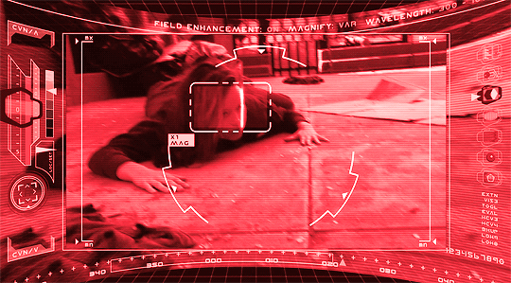
Facial Verification
Notes:
https://evasions.checkpoint.com/src/Evasions/techniques/processes.html
https://stackoverflow.com/questions/2686096/c-get-username-from-process

Slide 90
Facial Verification
Webcam Frame Capture
Reference Image
Face Detection
Notes:
https://evasions.checkpoint.com/src/Evasions/techniques/processes.html
https://stackoverflow.com/questions/2686096/c-get-username-from-process

Slide 91
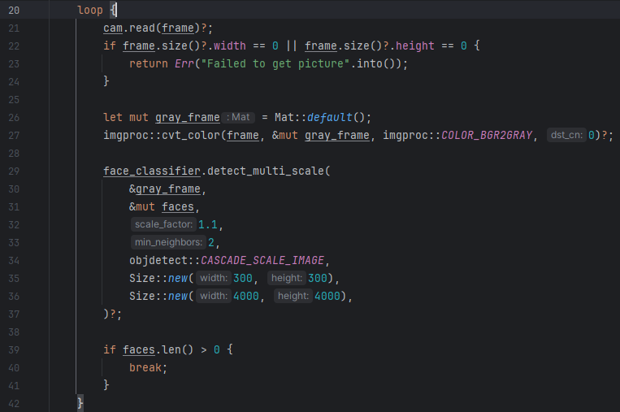

Facial Verification
Webcam Frame Capture
Reference Image
Face Detection
Notes:
https://evasions.checkpoint.com/src/Evasions/techniques/processes.html
https://stackoverflow.com/questions/2686096/c-get-username-from-process

Slide 92
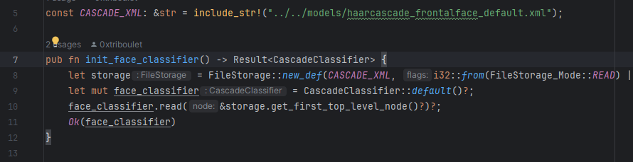
Facial Verification
Webcam Frame Capture
Reference Image
Face Detection
Notes:
https://evasions.checkpoint.com/src/Evasions/techniques/processes.html
https://stackoverflow.com/questions/2686096/c-get-username-from-process

Slide 93

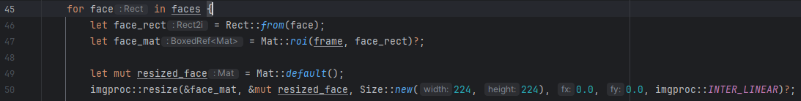
Facial Verification
Webcam Frame Capture
Reference Image
Face Detection
Crop Face and Resize Image
Notes:
https://evasions.checkpoint.com/src/Evasions/techniques/processes.html
https://stackoverflow.com/questions/2686096/c-get-username-from-process

Slide 94
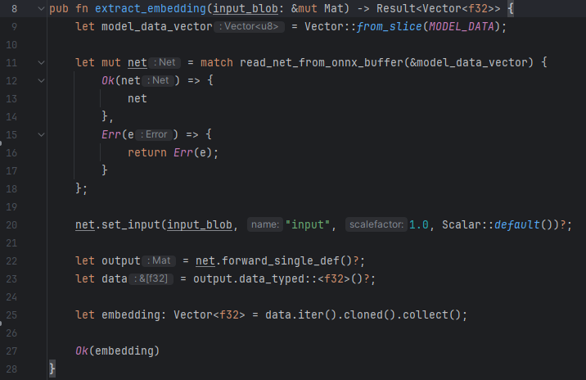
Facial Verification
Webcam Frame Capture
Reference Image
Face Detection
Crop Face and Resize Image
Extract Embeddings
Embeddings are representations of values or objects like text, images, and audio that are designed to be consumed by machine learning models and semantic search algorithms.
https://www.cloudflare.com/learning/ai/what-are-embeddings/
Notes:
https://evasions.checkpoint.com/src/Evasions/techniques/processes.html
https://stackoverflow.com/questions/2686096/c-get-username-from-process

Slide 95
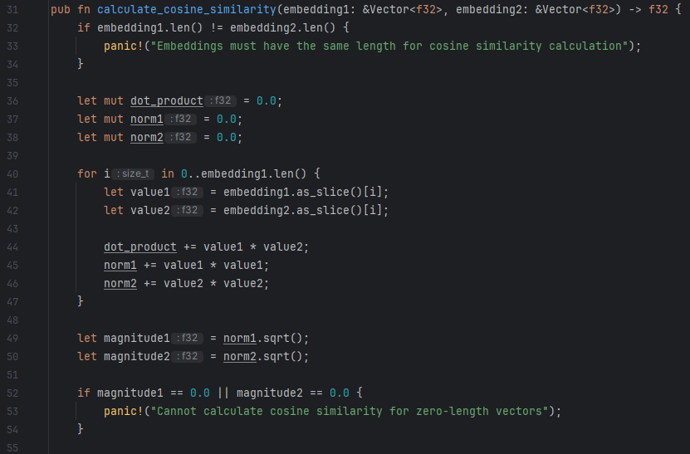
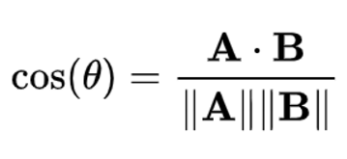
Facial Verification
Webcam Frame Capture
Reference Image
Face Detection
Crop Face and Resize Image
Extract Embeddings
Compare Vectors
Notes:
https://evasions.checkpoint.com/src/Evasions/techniques/processes.html
https://stackoverflow.com/questions/2686096/c-get-username-from-process

Slide 96
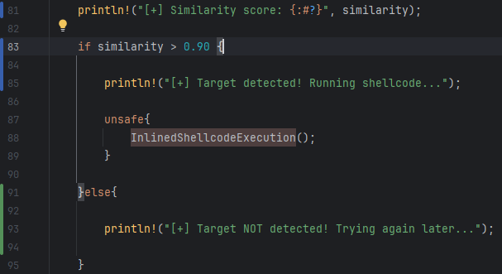
Facial Verification
Webcam Frame Capture
Reference Image
Face Detection
Crop Face and Resize Image
Extract Embeddings
Compare Vectors
Output Classification
Notes:
https://evasions.checkpoint.com/src/Evasions/techniques/processes.html
https://stackoverflow.com/questions/2686096/c-get-username-from-process

Slide 97
Demo

Slide 98
Demo Discussion
Three scenarios

Slide 99
Demo Discussion
Three scenarios
John Connor comparison to me
>80% similarity, a bit high? Likely due to comparison being done on cropped images instead of key facial features

Slide 100
Demo Discussion
Three scenarios
John Connor comparison to me
>80% similarity, a bit high? Likely due to comparison being done on cropped images instead of key facial features
John Connor comparison to John Connor
Same image used for reference as print out due to John Connor’s unavailability at the time of testing

Slide 101
Demo Discussion
Three scenarios
John Connor comparison to me
>80% similarity, a bit high? Likely due to comparison being done on cropped images instead of key facial features
John Connor comparison to John Connor
Same image used for reference as print out due to John Connor’s unavailability at the time of testing
LinkedIn pfp to me
Final validation to confirm facial verification mechanism could recognize the same individual

Slide 102
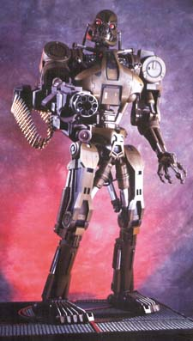
Back to our question
Can we use AI/ML to refine existing attack methods?
Loader Design
VM Detection
Target User Verification
https://terminator.fandom.com/wiki/T-70
Notes:
https://evasions.checkpoint.com/src/Evasions/techniques/processes.html
https://stackoverflow.com/questions/2686096/c-get-username-from-process

Slide 103
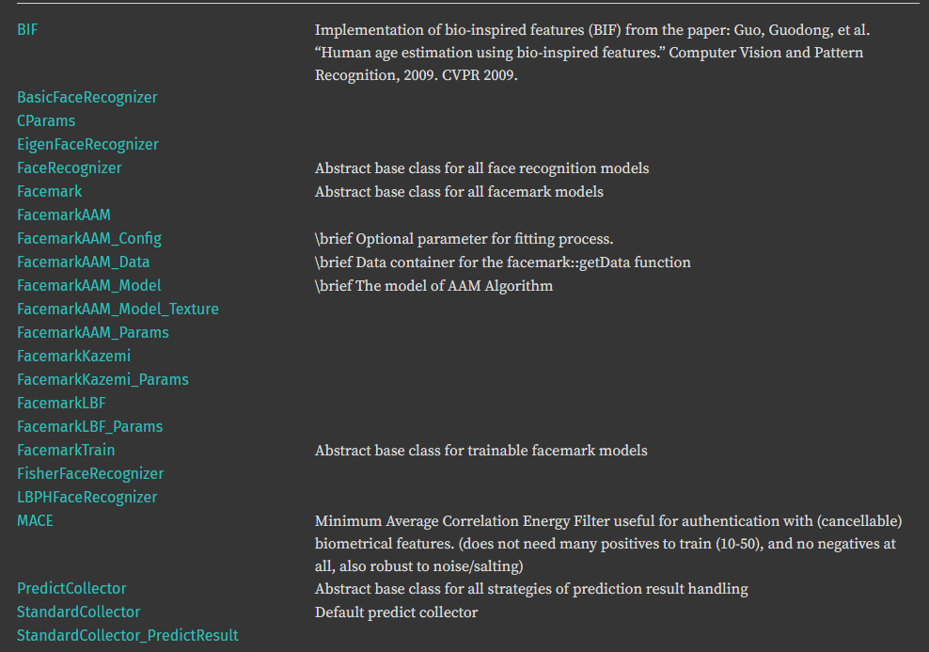
Alternative Approaches
OpenCV ML primitives could be used to train a model in Python
Model could then be used at runtime like the CascadeClassifier
https://terminator.fandom.com/wiki/T-70
Notes:
https://evasions.checkpoint.com/src/Evasions/techniques/processes.html
https://stackoverflow.com/questions/2686096/c-get-username-from-process

Slide 104
Alternative Approaches
OpenCV ML primitives could be used to train a model in Python
Model could then be used at runtime like the CascadeClassifier
Resnet50 or other visual recognition model could be used for better accuracy
executable ~26MB -> ~100MB
https://terminator.fandom.com/wiki/T-70
Notes:
https://evasions.checkpoint.com/src/Evasions/techniques/processes.html
https://stackoverflow.com/questions/2686096/c-get-username-from-process

Slide 105
Alternative Approaches
OpenCV ML primitives could be used to train a model in Python
Model could then be used at runtime like the CascadeClassifier
Resnet50 or other visual recognition model could be used for better accuracy
executable ~26MB -> ~100MB
Models could be remotely staged on GitHub/HuggingFace and downloaded/used by the executable at runtime
https://terminator.fandom.com/wiki/T-70
Notes:
https://evasions.checkpoint.com/src/Evasions/techniques/processes.html
https://stackoverflow.com/questions/2686096/c-get-username-from-process

Slide 106
Future Research
Bring Your Own Intelligence
Load AI/ML Capabilities via BOF
AI/ML Capabilities in PIC
OCR data exfiltration
Runtime modeling of target system
Teamserver command automation
https://github.com/0xTriboulet/T-1
https://github.com/0xTriboulet/T-70
https://terminator.fandom.com/wiki/T-70
Notes:
https://evasions.checkpoint.com/src/Evasions/techniques/processes.html
https://stackoverflow.com/questions/2686096/c-get-username-from-process

Slide 107
Special Thanks to…
https://github.com/twistedfall
@C5pider
@NotNordgaren
@m4ul3r_0x00
@mrd0x
A bunch of other people
Notes:
https://evasions.checkpoint.com/src/Evasions/techniques/processes.html
https://stackoverflow.com/questions/2686096/c-get-username-from-process

Slide 108
Fin

